Slide 1
The Machine Learning & Deep Learning Show
Lecture 05
25th June 2020

Slide 2
Transfer Learning

Slide 3
What is a pretrained model ?

Slide 4
Pretrained Model
A pre-trained model is a saved network that was previously trained on a large dataset, typically for a large-scale image-classification task.
The exciting thing about pre-trained models is we can transfer learning from one pre-trained model to another task.
Similar to a human who learned to play piano, transferring some of that knowledge and skill to guitar.

Slide 5
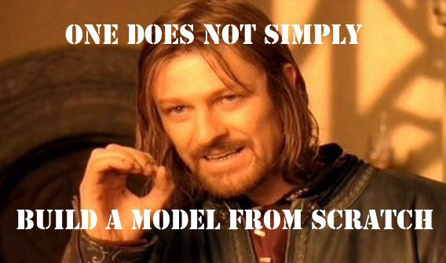
Transfer Learning

Slide 6
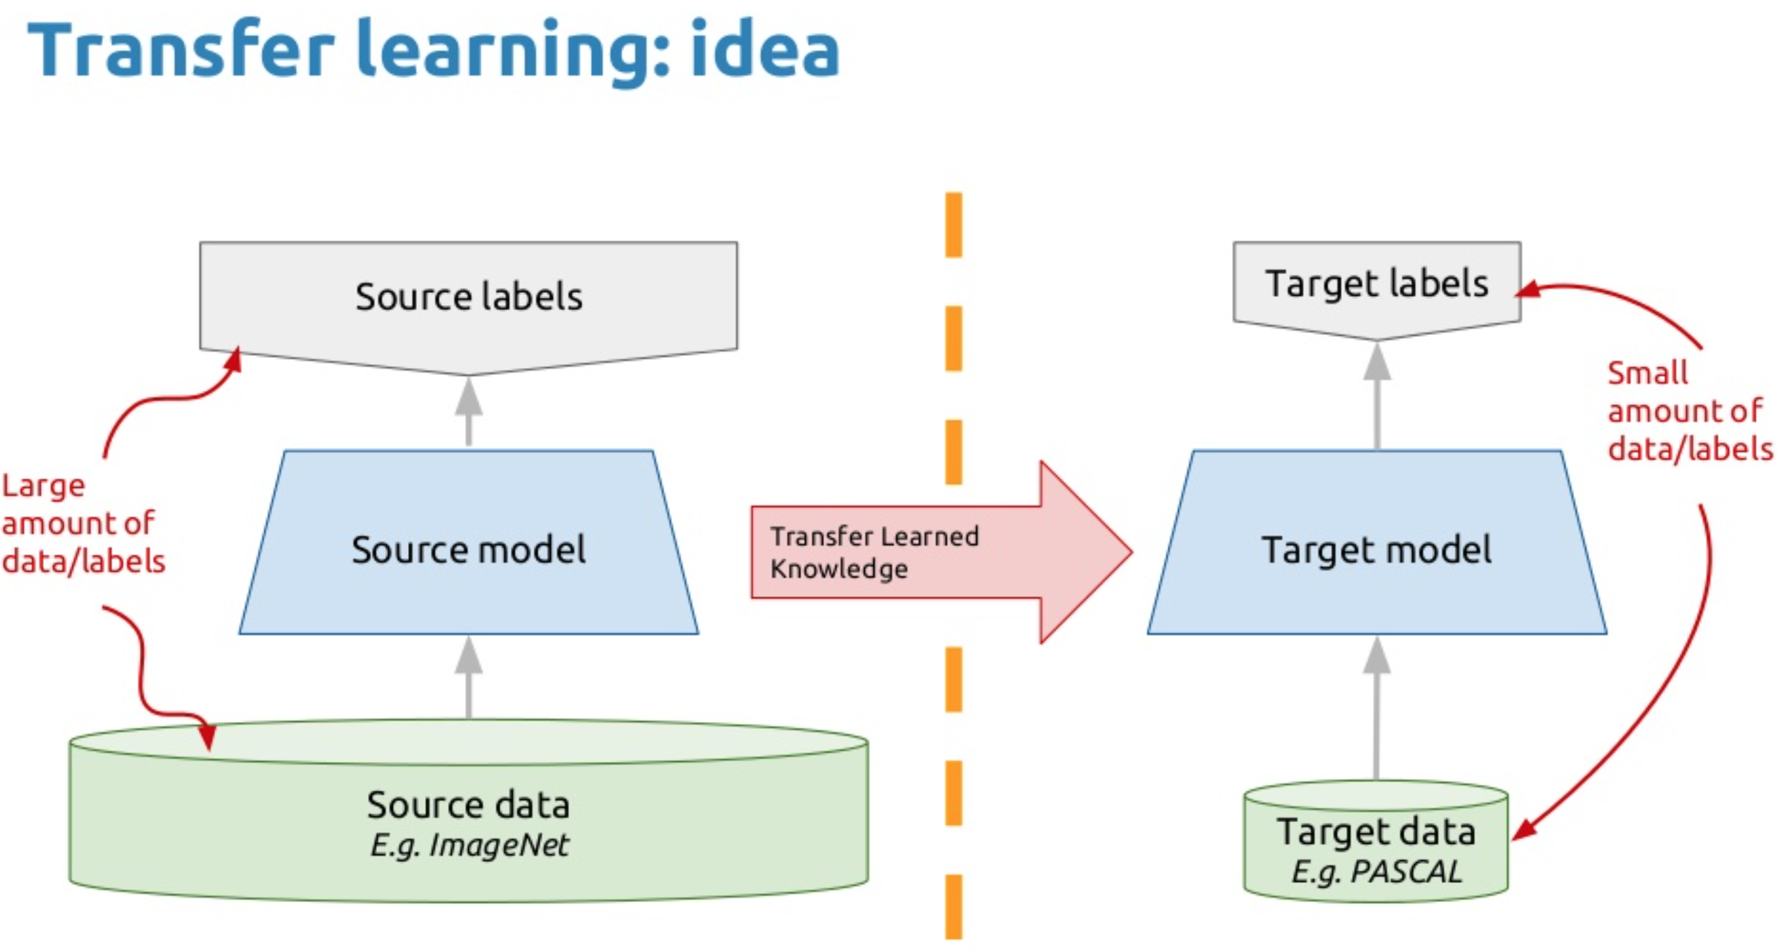

Slide 7
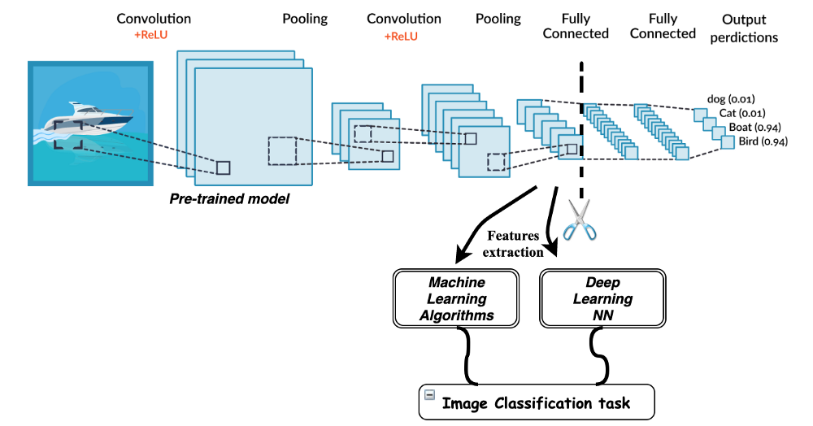
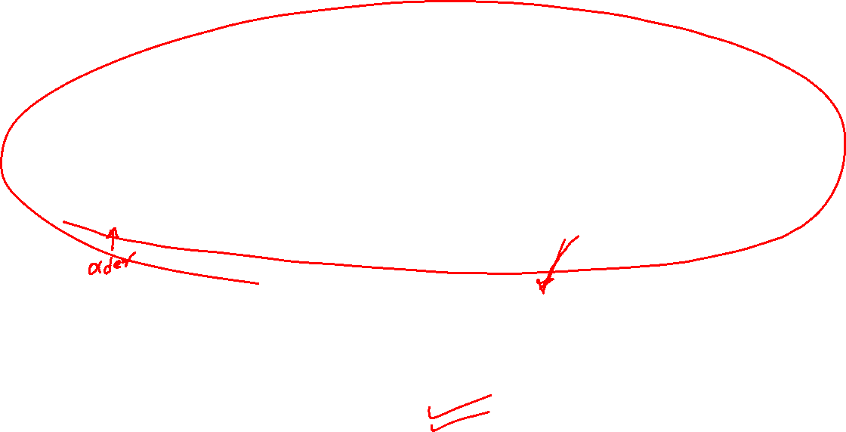
Transfer Learning
Credits: https://missinglink.ai/guides/convolutional-neural-networks/convolutional-neural-network-tutorial-basic-advanced/

Slide 8
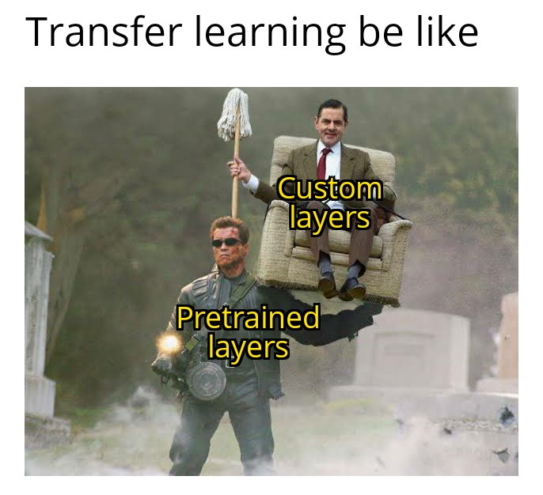
Transfer Learning

Slide 9
What is a feature extraction ?

Slide 10
Feature Extraction
Use the representations learned by a previous network to extract meaningful features from new samples. You simply add a new classifier, which will be trained from scratch, on top of the pretrained model so that you can repurpose the feature maps learned previously for our dataset.
You do not need to (re)train the entire model. The base convolutional network already contains features that are generically useful for classifying pictures. However, the final, classification part of the pretrained model is specific to original classification task, and subsequently specific to the set of classes on which the model was trained.

Slide 11
Fine Tuning
Fine-Tuning: Unfreezing a few of the top layers of a frozen model base and jointly training both the newly-added classifier layers and the last layers of the base model. This allows us to "fine tune" the higher-order feature representations in the base model in order to make them more relevant for the specific task.

Slide 12
Demo

Slide 13
Recurrent Neural Network

Slide 14
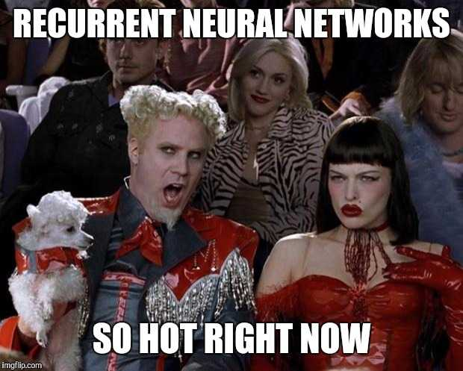

Slide 15
Recurrent Neural Network
A recurrent neural network (RNN) is a class of artificial neural networks where connections between nodes form a directed graph along a temporal sequence. This allows it to exhibit temporal dynamic behavior.
LSTM
Long short-term memory (LSTM) is an artificial recurrent neural network (RNN) architecture used in the field of deep learning. Unlike standard feedforward neural networks, LSTM has feedback connections.

Slide 16
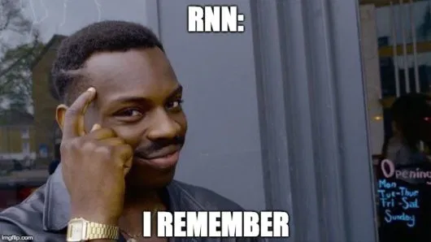
Recurrent Neural Networks
Understanding ML through Memes

Slide 17

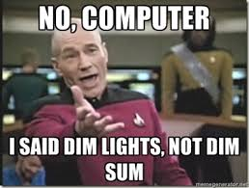
Applications
Stock Market Predictions
Language Translation
Natural Language Processing
Text Summarization
Speech Recognition

Slide 18
Saving Model & Weights

Slide 19

Saving Model & Weights

Slide 20
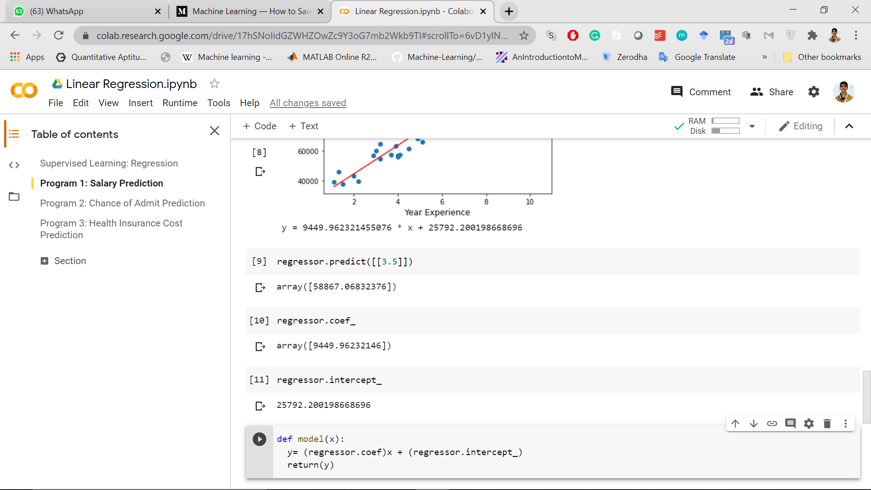
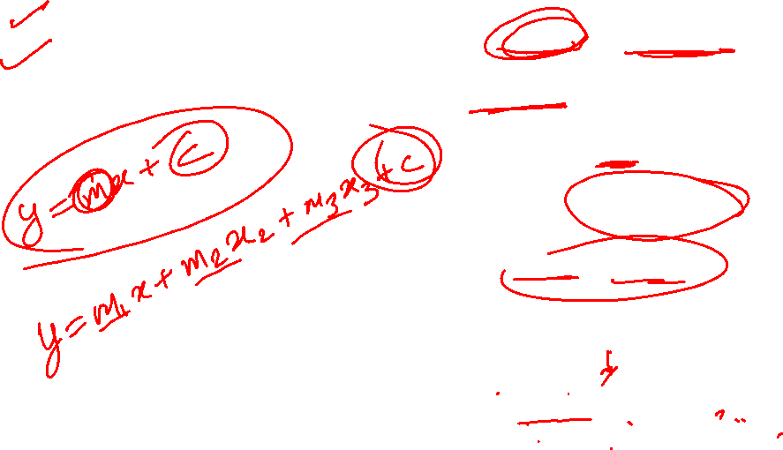
Saving Linear Regression Weights
lm.coef_
Print(regressor.coef_)
Print(regressor.intercept_)

Slide 21
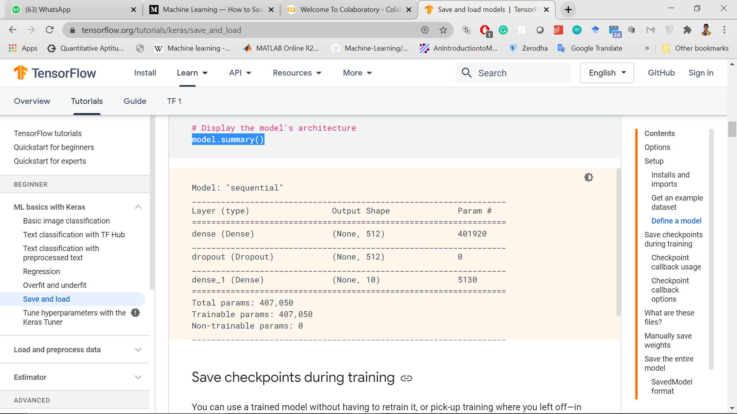
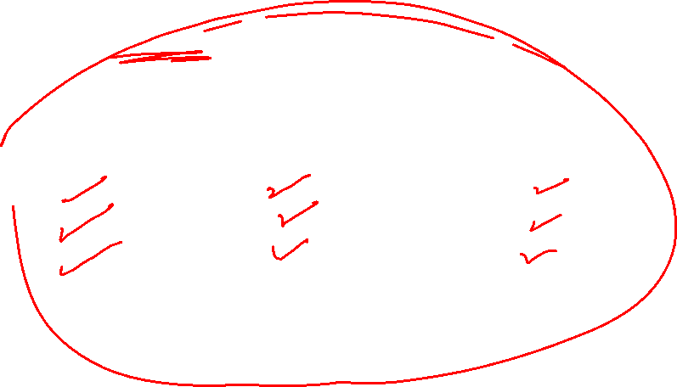
Neural Network Model Summary
model.summary()

Slide 22
Azure Custom Vision
https://www.customvision.ai/

Slide 23
Azure Face API
https://azure.microsoft.com/en-in/services/cognitive-services/face/#features

Slide 24
Azure ML Studio
Free | No Subscription Req
https://studio.azureml.net/

Slide 25

Azure ML Studio

Slide 26

Azure ML Studio

Slide 27
About Model Deployment

Slide 28
About GPA Prediction Model
Step 1: I created Linear Regression model and extracted all the weights
Step 2: I created a ASP .NET Web App on Visual Studio Essentials
Step 3: Created a form Step 4: Wrote function which takes past GPA and predicts next
Ta.. Da… “Project’s Ready”

Slide 29
Using Xamarin Mobile App
Use the model API for prediction
Import the .tf or .tflite model and use them in your mobile application

